Slide 1
DeepTurkish: Turkish Automatic Speech Recognition with End2End Neural Networks
Recep Oğuz Araz
ELEC390
26.01.2021

Slide 2
Contents
Task Description
Background
Neural Network Architecture
Connectionist Temporal Classification Function
Decoder Types
Performance
Challenges
Future Work

Slide 3
Task Description
We implemented the End2End Automatic Speech Recognition (ASR) system,
DeepSpeech 2 (DS2) for Turkish
After training the Neural Network(NN), we integrated a Character and Word level Hybrid Language Model for decoding.
In the end we proposed a novel spell-checking algorithm based on the pretrained transformer, BERTurk.

Slide 4
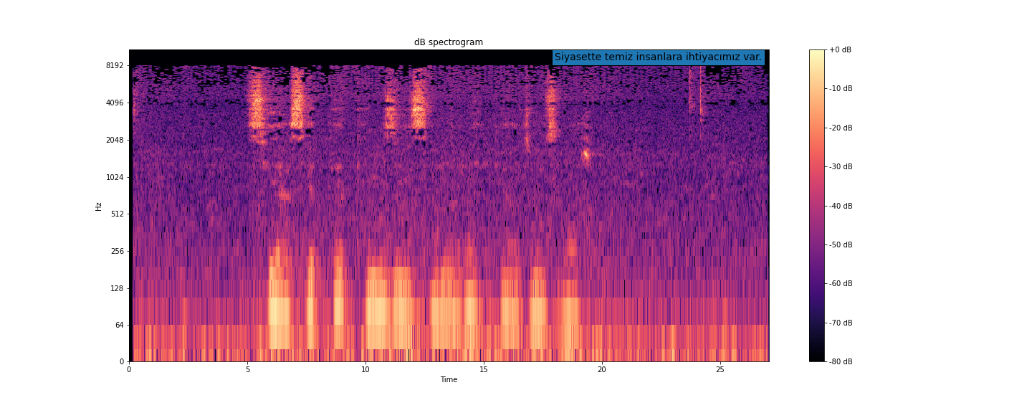
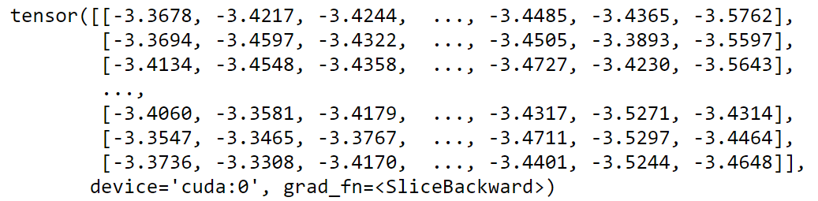

Background
$\text{N}\text{_}\text{alphabet}$ * T
“Siyasette temiz insanlara ihtiyacımız var.”
Model Inputs:
normalized power spectrogram inputs, corresponding utterance transcriptions
Model Output:
a log probability distribution matrix over all alphabet characters, independent for each time step

Slide 5
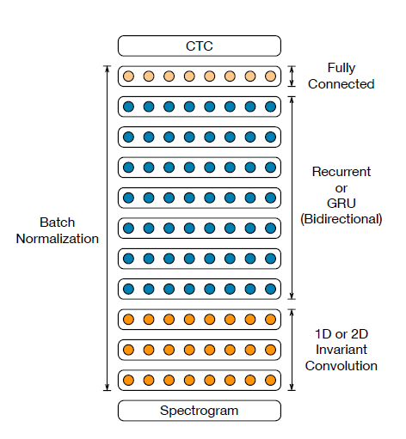
Network Architecture
Original Paper:
Convolutional Layer, shared input matrix BiGRU Layer, FC layer. ReLU activation between input layers and Log Softmax at Output layer.
Batch Normalization, Stride 2
Depth:
Baseline Model: 5 / Max: 11 layers
SortaGrad Curriculum

Slide 6
Our Implementation* AAI
3 layers of ResNET
FC
3 layers of BiGRU
Layer Norm
GELU
Dropout
https://www.comet.ml/site/customer-case-study-building-an-end-to-end-speech-recognition-model-in-pytorch-with-assemblyai/

Slide 7
CTC Function
CTC is sequence labeling function that does not require segmentation.
In a character-timestep probability matrix, where each step is assumed independent from the last,
For each possible transcription, there are many paths that can be followed through the probability matrix.
It penalizes the model outputs to maximize the probability that will result in given transcription.
Blank Token: Pizza

Slide 8
Decoding
To get a transcription from the probability distribution, we need to decode the matrix.

Slide 9
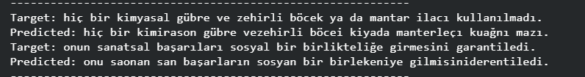
Argmax Decoding
One simple approximation is the Argmax Decoding
Examples:

Slide 10
Performance Evaluation
We compare the model predictions with the true transcriptions using the levenshtein distance.
It measures the difference between two sequences by the minimum number of single-entry edits required to convert the hypotheses sequence into the reference sequence.
Substitutions, insertion, deletion (,transposition)

Slide 11
Baseline Comparison
With the NN trained on METUbet dataset, and decoded with argmax decoding, we achieve:
0.225 average CER and 0.88 average WER.
Comparatively low with DS2 baseline model results:
0.105 CER, 0.119 WER
Attributed to number of parameters, training set size

Slide 12
Observing the distributions, authors of the original paper made a few observations and produced better solutions.
Beam Search Decoding
We model each possible transcription sequence as a beam in the probability matrix, update each beam and keep k best scoring beams.
Language Model integration
We implement character level trigram Language Model trained on various corpora to increase the metrics.

Slide 13
Beam Search With Trigram Character LM:
CER: 0.21, WER: 0.79
Prefix Search:
CER: 0.33, WER: 0.96
Lexicon Search with Trigram Beam Search Approximation
CER: 0.32, WER: 0.89

Slide 14
We hypothesized that the result of the Lexicon Search indicates the model capacity is insufficient for the task.
The probabilities of the true words in the CTC matrix are too low to be detected by the Beam Search algorithm.
Therefore, we increase the model Complexity and evaluated metrics again.

Slide 15
Complex Model Test Performance:
Beam Search With Trigram Character LM:
CER: 0.210, WER: 0.79
Lexicon Search with Trigram Beam Search Approximation
CER: 0.30, WER: 0.87
Because both performances are same as before,
We conclude that we obtained the best achievable results from this dataset-NN combination and the LM BeamSearch Decoder.

Slide 16
Challenges
In order to achieve the results of the original paper, we need 10.000 hours of speech
Our dataset consists of 8 hours of speech in METUbet and 14 hours in Mozilla.
To increase the dataset size, we need a larger memory to store all the spectrograms. (Colab 40 GB limit)

Slide 17
Future Work: Spell Checking with Transformers
Given a large vocabulary, and a pretrained Transformer,
We propose a novel spell checker, where the system does not know if a mistake is done a priori.
We mask the output sequence word by word in a random permutation order,
get a prediction from the transformer and order the predictions with respect to levenshtein distance
Perform correction if distance is below tolerance.

Slide 18
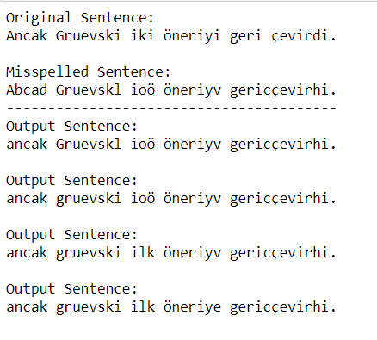
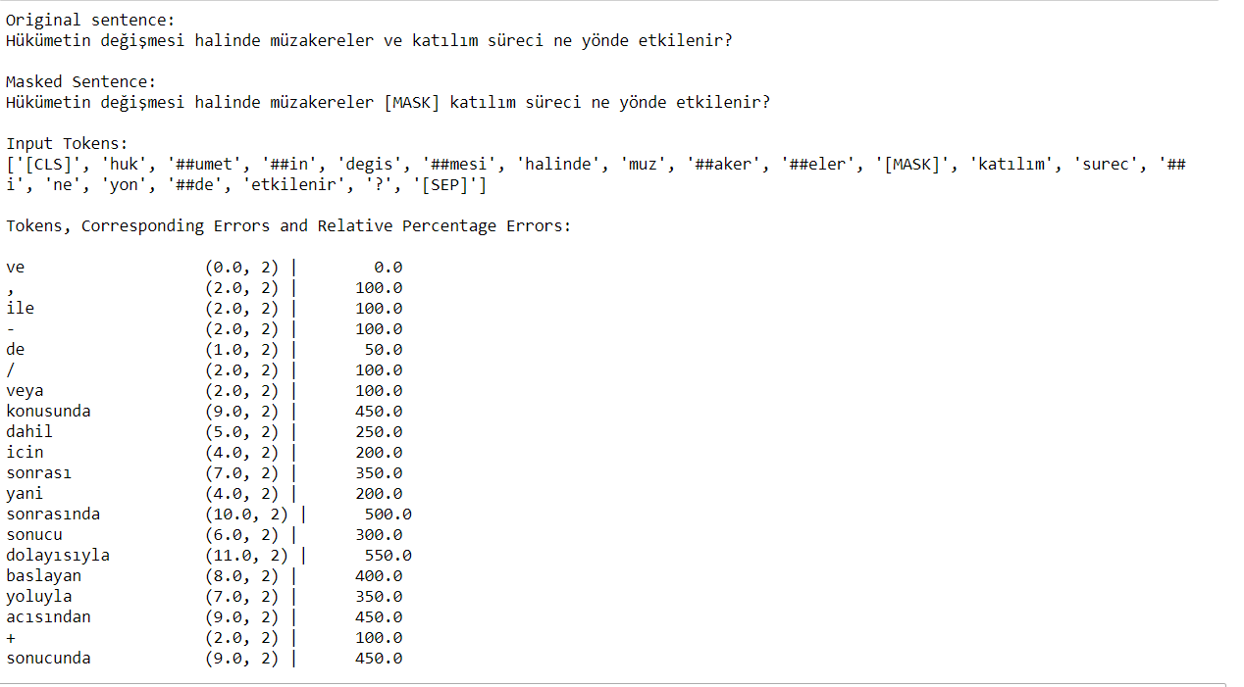
We claim that if the WER is below 50%, good corrections can be found in reasonable time.

Slide 19
Practiced Soft Skills
Spectrogram Resolution Optimization
Amplitude, dB, Power spectrograms
Audio Cleaning
Corpora Forming
Probability to Log Probability Conversion
Modular Programming
PyTorch, Wandb interfaces

Slide 20
Thanks to Prof. Engin Erzin and PhD. Tuğteki Turan!

